Slide 1
DATA MANIPULATION
Lecture slides are adapted/modified from slides provided by the textbook, Computer Science: An Overview by J. Glenn Brookshear and Dennis Brylow
publisher Pearson

Slide 2
Data Manipulation
Computer Architecture
Machine Language
Program Execution
Arithmetic/Logic Instructions
Communicating with Other Devices
Other Architectures

Slide 3
Computer Architecture

Slide 4
Computer Architecture
Central Processing Unit (CPU) or processor
Arithmetic/Logic unit versus Control unit
Registers
General purpose
Special purpose
Bus
Motherboard

Slide 5
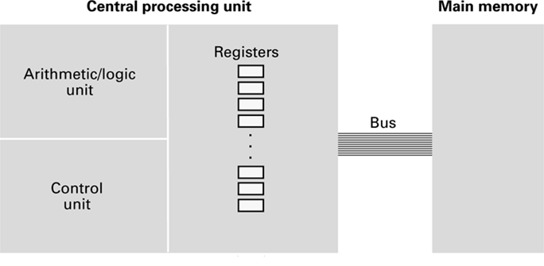
CPU and main memory connected via a bus

Slide 6
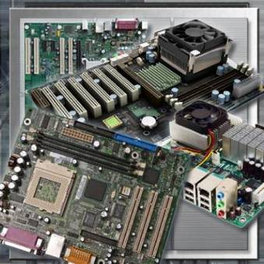
Motherboards
The motherboard
is the main printed circuit board.
contains the buses, or electrical pathways found in a computer. Buses allow data to travel among the various components.
accommodates CPU, RAM, expansion slots, heat sink/fan assembly, BIOS chip, chip set, sockets, internal and external connectors, various ports, and the embedded wires that interconnect the motherboard components.
Notes:
1.1.2.1 Identify the names, purposes, and characteristics of motherboards
A motherboard is also known as the system board, the backplane, or the main board.
Sockets, internal and external connectors, and various ports are also placed on the motherboard.

Slide 7
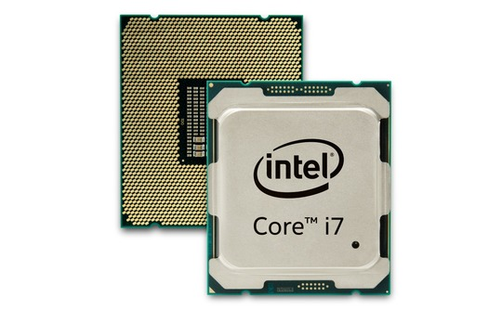
Central Processing Unit
The Central Processing Unit (CPU) is known as the brain of the computer. It is also referred to as the processor.
The CPU executes a program, which is a sequence of stored instructions.
Notes:
1.1.2.2 Identify the names, purposes, and characteristics of CPUs
Most calculations take place in the CPU. CPUs come in different form factors, each style requiring a particular slot or socket on the motherboard. Common CPU manufacturers include Intel and AMD.
The CPU socket or slot is the connector that interfaces between the motherboard and the processor itself.
The CPU executes a program, which is a sequence of stored instructions. Each model of processor has an instruction set, which it executes. The CPU executes the program by processing each piece of data as directed by the program and the instruction set. While the CPU is executing one step of the program, the remaining instructions and the data are stored nearby in a special memory called cache. There are two major CPU architectures related to instruction sets:
Reduced Instruction Set Computer (RISC) – Architectures use a relatively small set of instructions, and RISC chips are designed to execute these instructions very rapidly.
Complex Instruction Set Computer (CISC) – Architectures use a broad set of instructions, resulting in fewer steps per operation.

Slide 8
Central Processing Unit
Some CPUs incorporate hyperthreading or hypertransport to enhance the performance of the CPU.
The amount of data that a CPU can process at one time depends on the size of the processor data bus.
Speed of the CPU is measured in cycles per second - megahertz (MHz) or gigahertz (GHz).
Overclocking is a technique used to make a processor work at a faster speed than its original specification.
Notes:
1.1.2.2 Identify the names, purposes, and characteristics of CPUs
With hyperthreading, the CPU has multiple pieces of code being executed simultaneously on each pipeline. To an operating system, a single CPU with hyperthreading appears to be two CPUs.
The speed of a CPU is rated in cycles per second. The speed of current CPUs is measured in millions of cycles per second, called megahertz (MHz), or billions of cycles per second, called gigahertz (GHz). This is also called the CPU bus or the front side bus (FSB). The wider the processor data bus width, the more powerful the processor is. Current processors have a 32-bit or a 64-bit processor data bus.
Overclocking is not a reliable way to improve computer performance and can result in damaging the CPU.
MMX enabled microprocessors can handle many common multimedia operations that are normally handled by a separate sound or video card. However, only software especially written to call MMX instructions can take advantage of the MMX instruction set.

Slide 9
Central Processing Unit
The latest processor technology has resulted in CPU manufacturers finding ways to incorporate more than one CPU core onto a single chip.
Dual Core CPU - Two cores inside a single CPU
Triple Core CPU - Three cores inside a single CPU
Quad Core CPU - Four cores inside a single CPU
Hexa-Core CPU - Six cores inside a single CPU
Octa-Core CPU - Eight cores inside a single CPU
Notes:
1.1.2.2 Identify the names, purposes, and characteristics of CPUs
The latest processor technology has resulted in CPU manufacturers finding ways to incorporate more than one CPU core onto a single chip. Many CPUs are capable of processing multiple instructions concurrently:
Single Core CPU – One core inside a single CPU chip that handles all of the processing capability. A motherboard manufacturer may provide sockets for more than one single processor, providing the ability to build a powerful, multi-processor computer.
Dual Core CPU – Two cores inside a single CPU chip in which both cores can process information at the same time.
Triple Core CPU – Three cores inside a single CPU that is actually a quad-core processor with one of the cores disabled.
Quad Core CPU – Four cores inside a single CPU in which all cores can process information simultaneously for enhanced software applications.
Hexa-Core CPU - Six cores inside a single CPU
Octa-Core CPU - Eight cores inside a single CPU

Slide 10
The Arithmetic/Logic Unit
Subsystem that performs addition, subtraction, and comparison for equality
Components
Registers, interconnections between components, and the ALU circuitry
Register
Storage cell that holds the operands of an arithmetic operation and holds its result
Bus
Path for electrical signals

Slide 11
The Arithmetic/Logic Unit
Registers are similar to RAM with following minor differences
They do not have a numeric memory address but are accessed by a special register designator such as A, X or R0
They can be accessed much more quickly than regular memory cells
They are not used for general purpose storage but for specific purposes such as holding the operands for an upcoming arithmetic computations.
A typical ALU has 16, 32 or 64 registers.

Slide 12
The Control Unit
Control unit
Tasks: fetch, decode, and execute

Slide 13
Machine Language

Slide 14
Stored Program Concept
A program can be encoded as bit patterns and stored in main memory.
From there, the CPU can then extract the instructions and execute them.
In turn, the program to be executed can be altered easily.

Slide 15
Terminology
Machine instruction: An instruction (or command) encoded as a bit pattern recognizable by the CPU
Machine language: The set of all instructions recognized by a machine

Slide 16
Machine Language Philosophies
Reduced Instruction Set Computing (RISC)
Few, simple, efficient, and fast instructions
Examples: PowerPC from Apple/IBM/Motorola and ARM
Complex Instruction Set Computing (CISC)
Many, convenient, and powerful instructions
Example: Intel
Notes:
AMD: Advanced Micro Devices
ARM: Advanced RISC Machine (low power consumption). Game controller, digital TV, ..

Slide 17
Machine Instruction Types
Data Transfer: copy data from one location to another
Arithmetic/Logic: use existing bit patterns to compute a new bit patterns
Control: direct the execution of the program

Slide 18
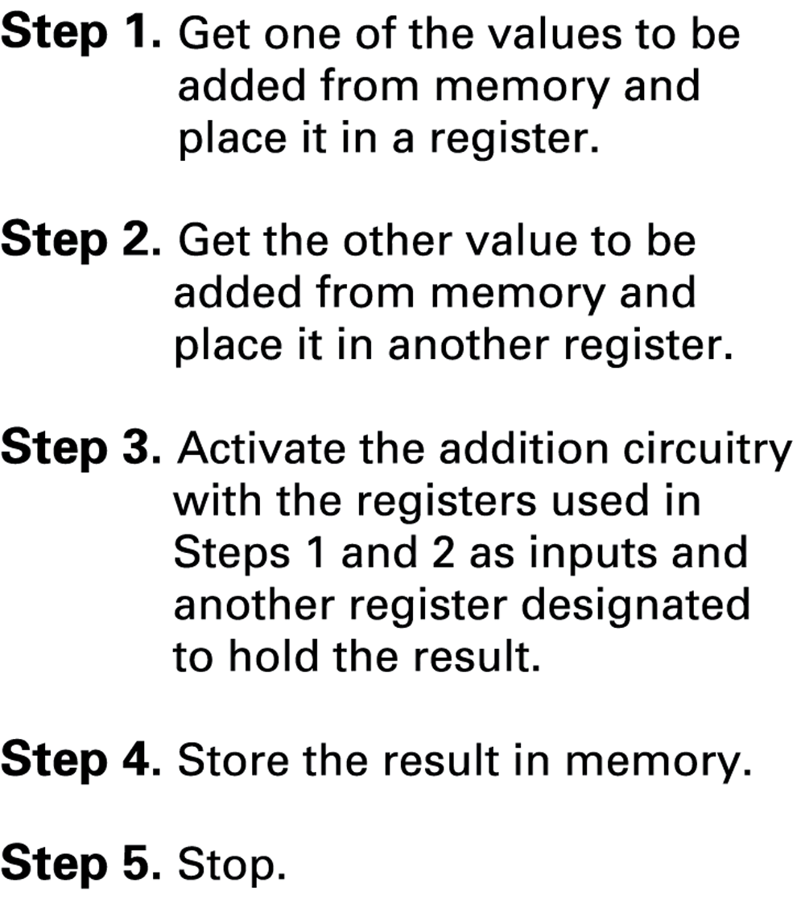
Adding values stored in memory

Slide 19
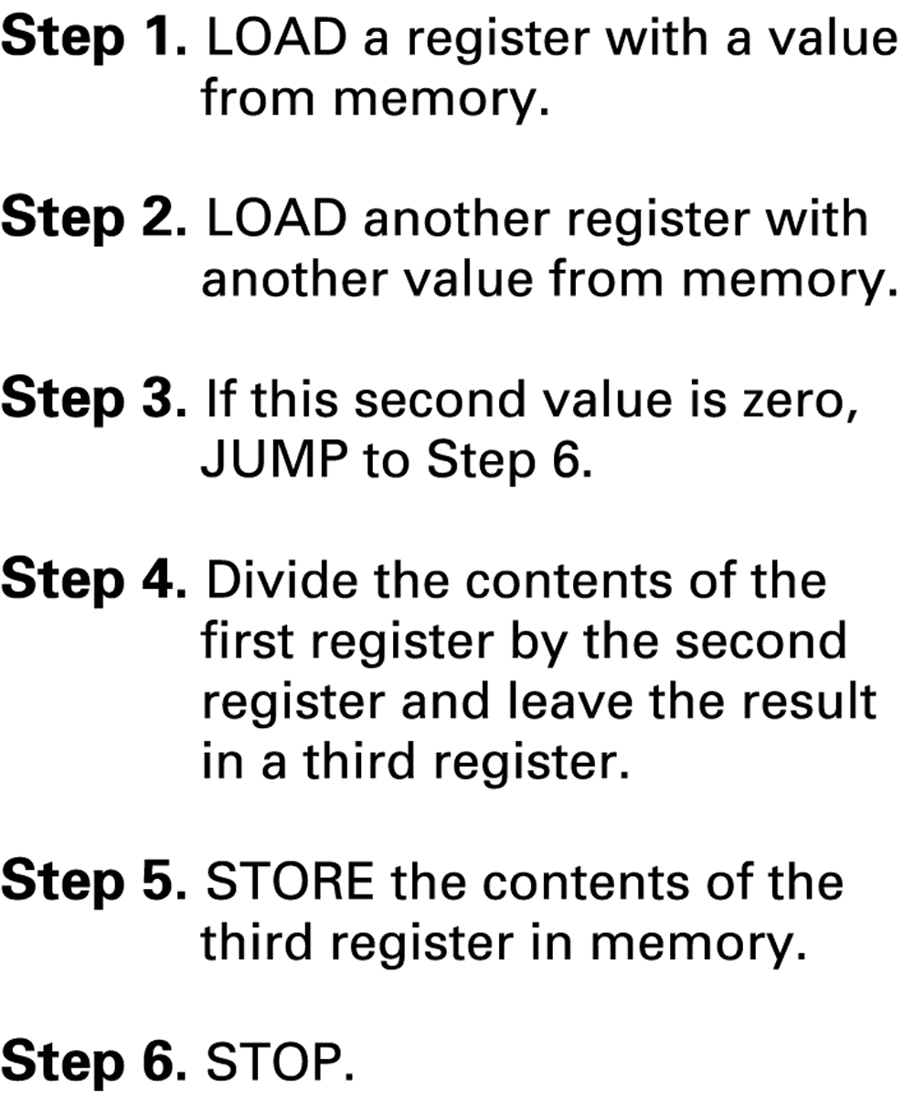
Dividing values stored in memory

Slide 20
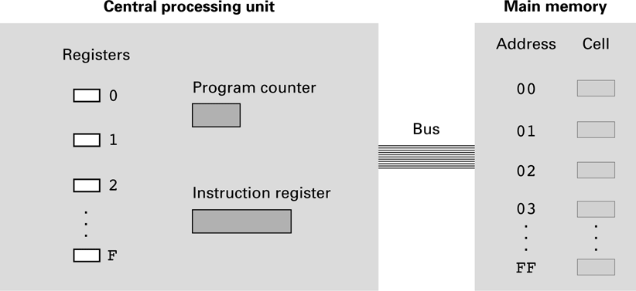
An architecture of the machine

Slide 21
Parts of a Machine Instruction
Op-code: Specifies which operation to execute
Operand: Gives more detailed information about the operation
Interpretation of operand varies depending on op-code

Slide 22
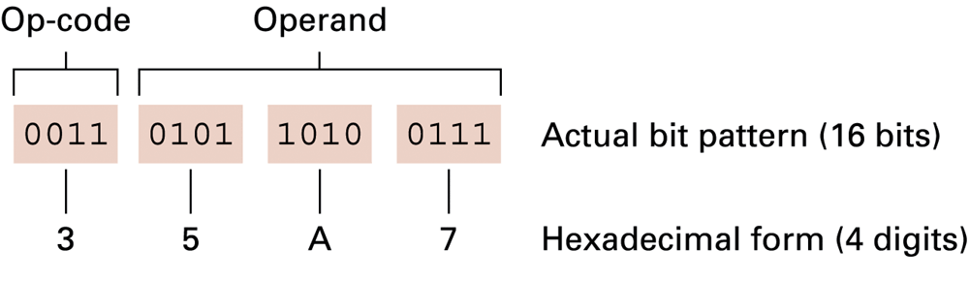
The composition of an instruction

Slide 23
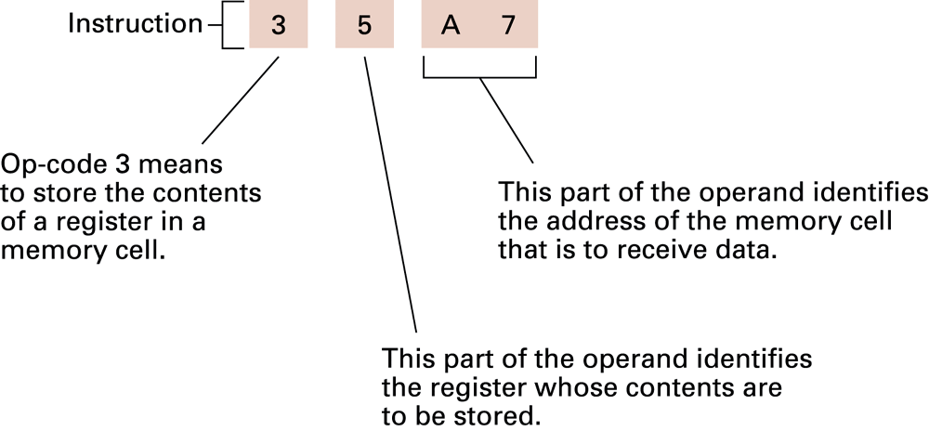
Decoding the instruction 35A7

Slide 24
A Simple Machine Language
Op-code | Operand | Description
1 | RXY | LOAD reg. R from cell XY.
2 | RXY | LOAD reg. R with XY.
3 | RXY | STORE reg. R at XY.
4 | 0RS | MOVE R to S.
5 | RST | ADD S and T into R. (2’s comp.)
6 | RST | ADD S and T into R. (floating pt.)

Slide 25
A Simple Machine Language
Op-code | Operand | Description
7 | RST | OR S and T into R.
8 | RST | AND S and T into R.
9 | RST | XOR S and T into R.
A | R0X | ROTATE reg. R X times.
B | RXY | JUMP to XY if R = reg. 0.
C | 0 | HALT.

Slide 26
A Simple Machine Language
14A3: Load
The contents of the memory cell located at address A3 to be placed in register 4.
20A3: Load
The value A3 to be placed in register 0.
35B1: Store
The contents of register 5 to be placed in the memory cell whose address is B1.
40A4: Move
The contents of register A to be copied into register 4.

Slide 27
A Simple Machine Language
5726: Add
The binary values in registers 2 and 6 to be added and the sum placed in register 7.
634E: Add
The values in registers 4 and E to be added as floating-point values and the result to be placed in register 3.

Slide 28
A Simple Machine Language
7CB4: Or
The result of ORing the contents of registers B and 4 to be placed in register C.
8045: And
The result of ANDing the contents of registers 4 and 5 to be placed in register 0.
95F3: Xor
The result of XORing the contents of registers F and 3 to be placed in register 5.
A403: Rotate
The contents of registers 4 to be rotated 3 bits to the right in a circular fashion.

Slide 29
A Simple Machine Language
B43C:
Compare the contents of register 4 with the contents of register 0.
If equal, the pattern 3C would be placed in the program counter so that the next execution executed would be the one located at that memory address.
Otherwise, nothing would be done.
C000:
Stop program execution.

Slide 30
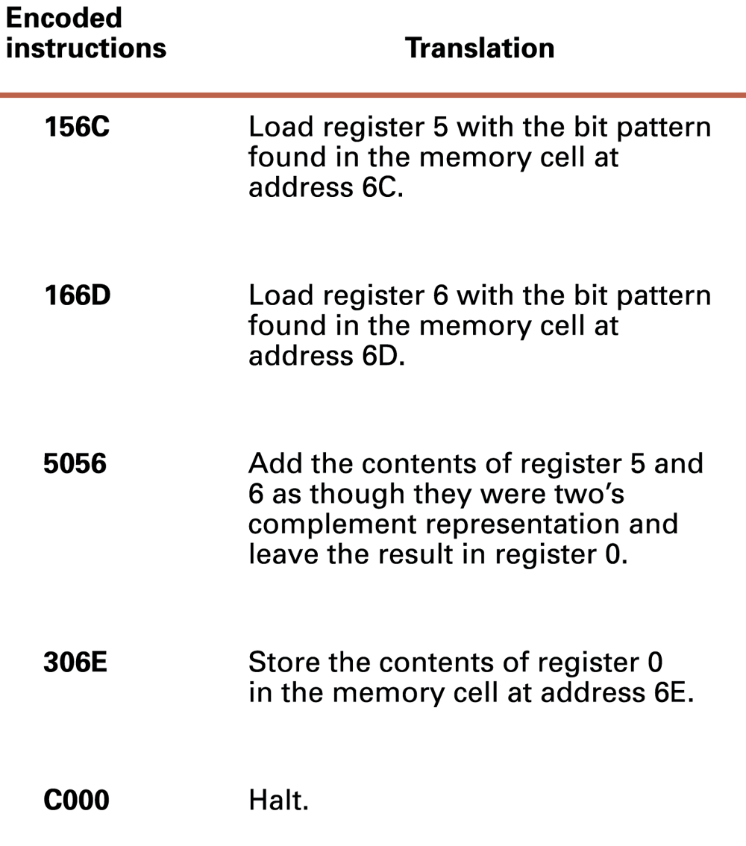
An encoded version of the instructions

Slide 31
Quiz
The following are instructions written in the above simple machine language. Rewrite in English.
368A
BADE
803C
40F4

Slide 32
Quiz
What is the difference between the instructions 15AB and 25AB in the simple machine language?

Slide 33
Quiz
Here are some instructions in English. Translate each of them into the simple machine language.
LOAD register number 3 with the hexadecimal 56.
ROTATE register number 5 three bits to the right.
AND the contents of register A with the contents of register 5 and leave the result in register 0.

Slide 34
Quiz
Here are some instructions in English. Translate each of them into the simple machine language.
LOAD register number 3 with the hexadecimal 56.
2356
ROTATE register number 5 three bits to the right.
A503
AND the contents of register A with the contents of register 5 and leave the result in register 0.
80A5

Slide 35
Program Execution

Slide 36
Program Execution
Controlled by two special-purpose registers
Program counter: address of next instruction
Instruction register: current instruction
Machine Cycle
Fetch
Decode
Execute

Slide 37
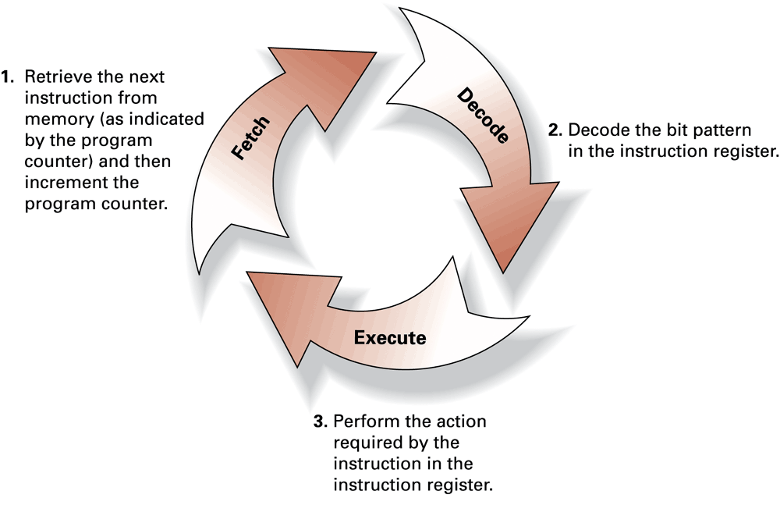
The machine cycle

Slide 38
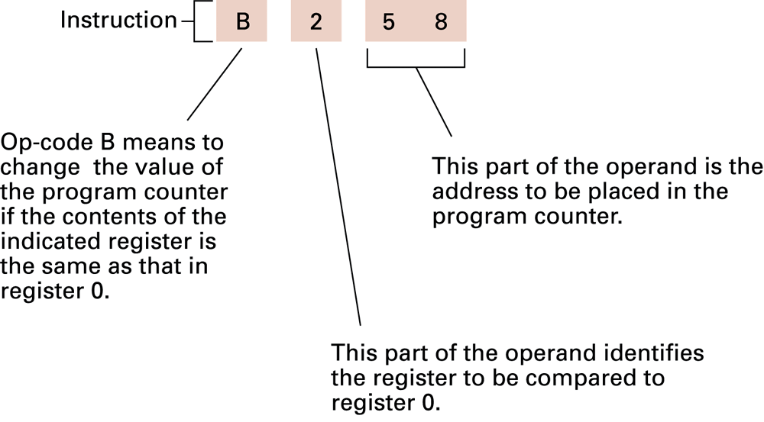
Decoding the instruction B258

Slide 39
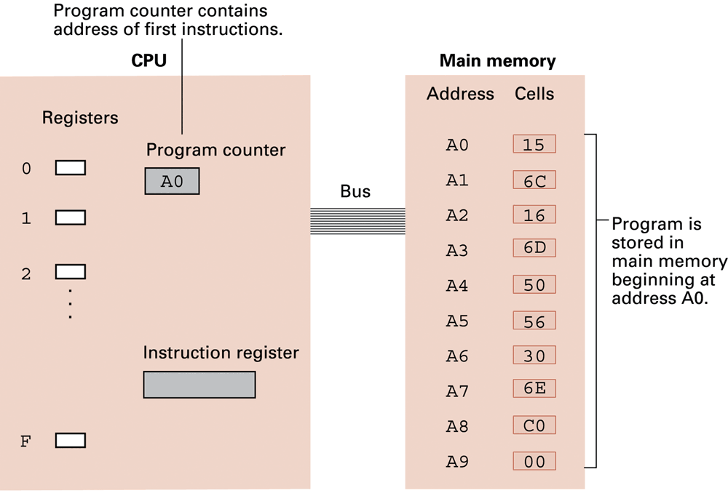
A program stored in main memory

Slide 40
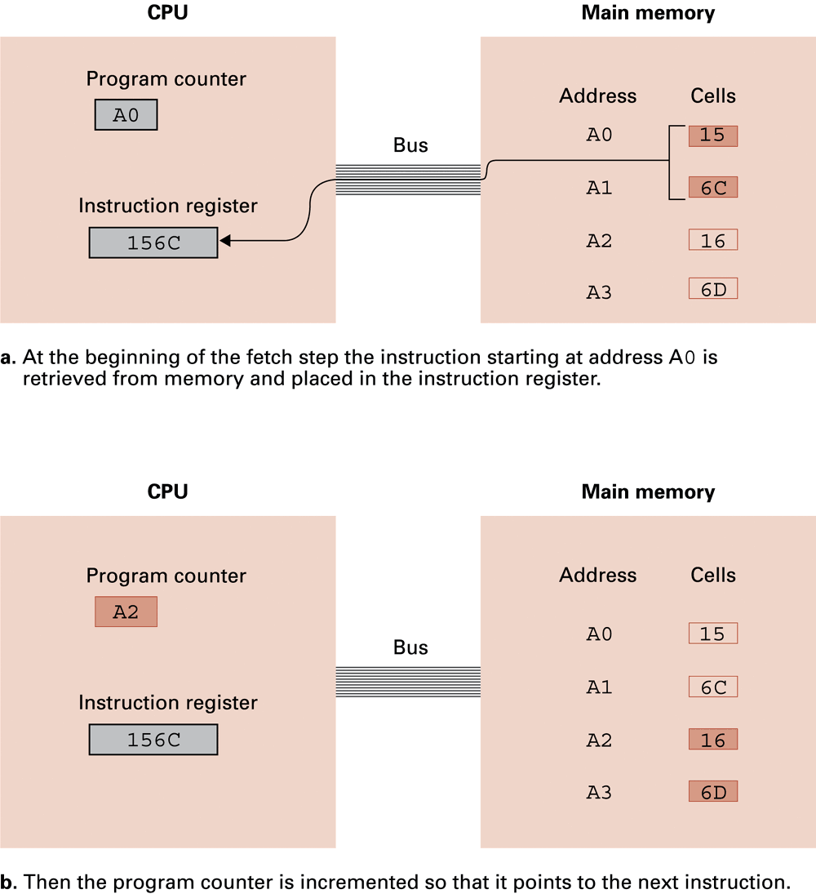
The fetch step of the machine cycle

Slide 41
The fetch step of the machine cycle

Slide 42
Arithmetic/Logic Instructions

Slide 43
Arithmetic/Logic Operations
Logic: AND, OR, XOR
Masking
Rotate and Shift:
circular shift (rotation)
logical shift
arithmetic shift
Arithmetic: add, subtract, multiply, divide
Precise action depends on how the values are encoded (two’s complement versus floating-point).

Slide 44
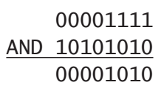
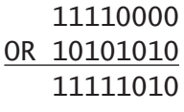
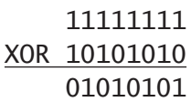
Masking

Slide 45
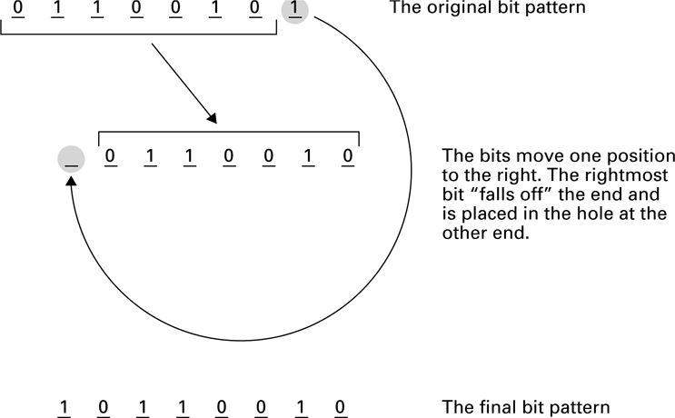
Circular shift

Slide 46
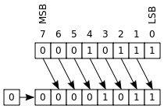
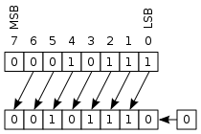
Logical shift

Slide 47
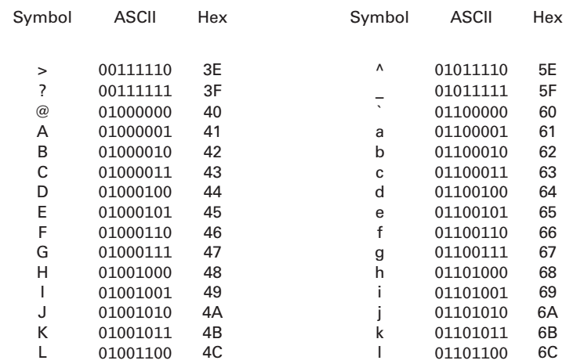
Quiz
What logical operation together with what mask can you use to change ASCII codes of lower characters to uppercase? What about uppercase to lowercase?

Slide 48
Quiz
Identify both the mask and the logical operation needed to accomplish each of the following objectives:
Put 1s in the upper 4 bits of an 8-bit pattern without disturbing the other bits.
Complement the most significant bit of an 8-bit pattern without changing the other bits.
Complement a pattern of 8 bits.
Put a 0 in the least significant bit of an 8-bit pattern without disturbing the other bits.

Slide 49
Quiz
Identify both the mask and the logical operation needed to accomplish each of the following objectives:
Put 1s in the upper 4 bits of an 8-bit pattern without disturbing the other bits.
OR 1111 0000
Complement the most significant bit of an 8-bit pattern without changing the other bits.
XOR 1000 0000
Complement a pattern of 8 bits.
XOR 1111 1111
Put a 0 in the least significant bit of an 8-bit pattern without disturbing the other bits.
AND 1111 1110

Slide 50
Quiz
Identify both the mask and the logical operation needed to accomplish each of the following objectives:
Put 1s in all but the most significant bit of an 8-bit pattern without disturbing the most significant bit.
Filter out all of the green color component from an RGB bitmap image pixel in which the middle 8 bits of a 24-bit pattern store the green information.
Invert all of the bits in a 24-bit RGB bitmap
Set all the bits in a 24-bit RGB bitmap pixel to 1, indicating the color “white”.

Slide 51
Quiz
Identify a logical operation (along with a corresponding mask) that, when applied to an input string of 8 bits, produces an output string of all 0s if and only ifs the input string is 1000 0001.

Slide 52
Communicating with Other Devices

Slide 53
Communicating with Other Devices
Controller: An intermediary apparatus that handles communication between the computer and a device
Specialized controllers for each type of device
General purpose controllers (USB and FireWire)
Port: The point at which a device connects to a computer
Memory-mapped I/O: CPU communicates with peripheral devices as though they were memory cells

Slide 54
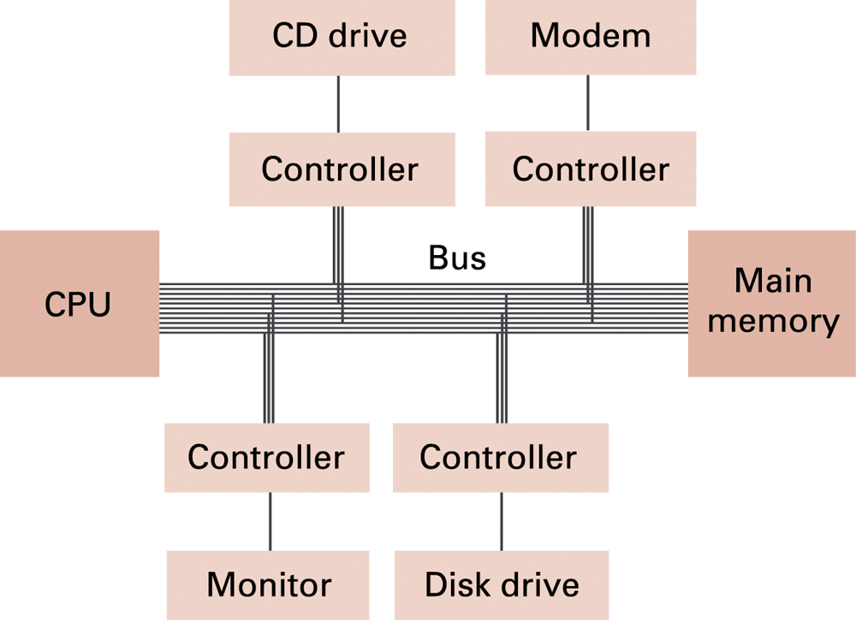
Controllers attached to a machine’s bus

Slide 55
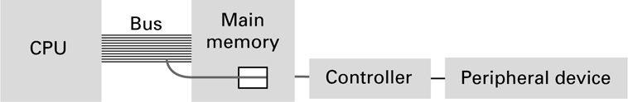
A conceptual representation of memory-mapped I/O

Slide 56
Communicating with Other Devices
Direct memory access (DMA): Main memory access by a controller over the bus
Von Neumann Bottleneck: Insufficient bus speed impedes performance
Handshaking: The process of coordinating the transfer of data between components

Slide 57
Communicating with Other Devices
Parallel Communication: Several communication paths transfer bits simultaneously.
Serial Communication: Bits are transferred one after the other over a single communication path.

Slide 58
Data Communication Rates
Measurement units
Bps: Bits per second
Kbps: Kilo-bps (1,000 bps)
Mbps: Mega-bps (1,000,000 bps)
Gbps: Giga-bps (1,000,000,000 bps)
Bandwidth: Maximum available rate

Slide 59
Quiz
Assume that the machine (using the simple machine language as described) uses memory-mapped I/O and that the address B5 is the location within the printer port to which data to be printed should be sent.
If register 7 contains the ASCII code for the letter A, what machine language instruction should be used to cause that letter to be printed at the printer?
If the machine executes a million instructions per second, how many times can this character be sent to the printer in one second?

Slide 60
Quiz
Assume that the machine (using the simple machine language as described) uses memory-mapped I/O and that the address B5 is the location within the printer port to which data to be printed should be sent.
If the printer is capable of printing five traditional pages of text per minute, will it be able to keep up with the characters being sent to it in (b)?

Slide 61
Quiz
Estimate how long it would take to transfer a 250-page novel (about 500,000 characters) encoded in 16-bit Unicode characters at a transfer rate of 54Mbps.

Slide 62
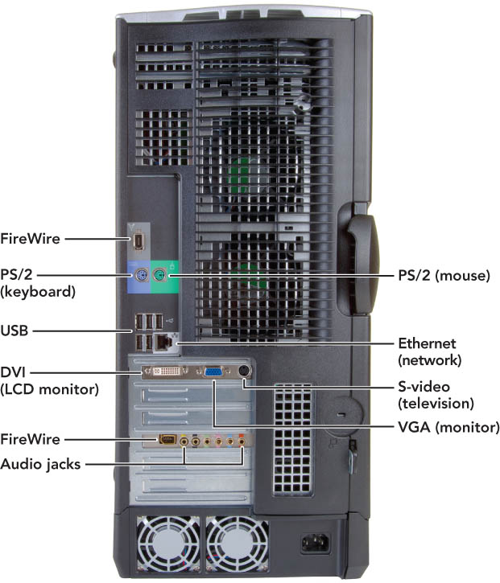
What’s on the Outside of the Box?

Slide 63
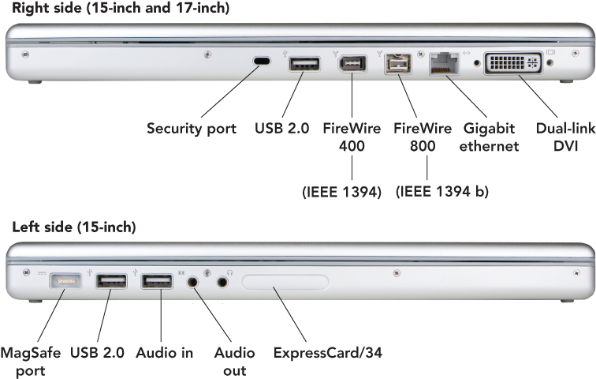
What’s on the Outside of the Box?
Connectors on a notebook may vary
Notes:
This is Figure 2.29.

Slide 64

Universal serial bus
USB (universal serial bus) ports
Connects up to 127 peripheral devices
USB 2.0 (high-speed USB)—fully compatible with USB 1.1 products, cables, and connectors
Designed to replace older parallel and serial ports
Connects a variety of devices to the computer, including:
Keyboards
Mice
Printers
Digital cameras

Slide 65
Universal serial bus
USB 2.0
Uses an external bus
Supports data transfer rates of 480 Mbps between the computer and the peripheral device
Supports hot swapping—ability to connect and disconnect devices without shutting down the computer
Plug-and-play (PnP)—allows computers to automatically detect the device when you plug it in
USB 3.0 (2008): 5Gbps
USB 3.1 (2013): 10Gbps
USB hub
Device that plugs into existing USB port
Contains four or more additional ports
Notes:
This is Figure 2.20.

Slide 66
FireWire
FireWire (1395 ports)
Created by Apple in 1995
IEEE 1394 Higher Performance Serial Bus, also known as Sony i.Link
Offers high-speed connections for dozens of peripheral devices (up to 63)
Enables hot swapping and PnP
Data transfer rates of FireWire
FireWire 400—400 Mbps
FireWire 800—800 Mbps
Declared “dead” by Steve Jobs.
Notes:
This is Figure 2.20.

Slide 67
Video connectors
VGA (video graphics array)
15-pin male connector—works with standard monitor cables
Transmits analog video signals
Used for legacy technology cathode ray (CRT) monitors
DVI (Digital visual Interface) port—lets LCD monitors use digital signals
Onboard video—video circuitry built into the motherboard where the video connector is on the back of the system unit case
Notes:
This is Figure 2.20.

Slide 68
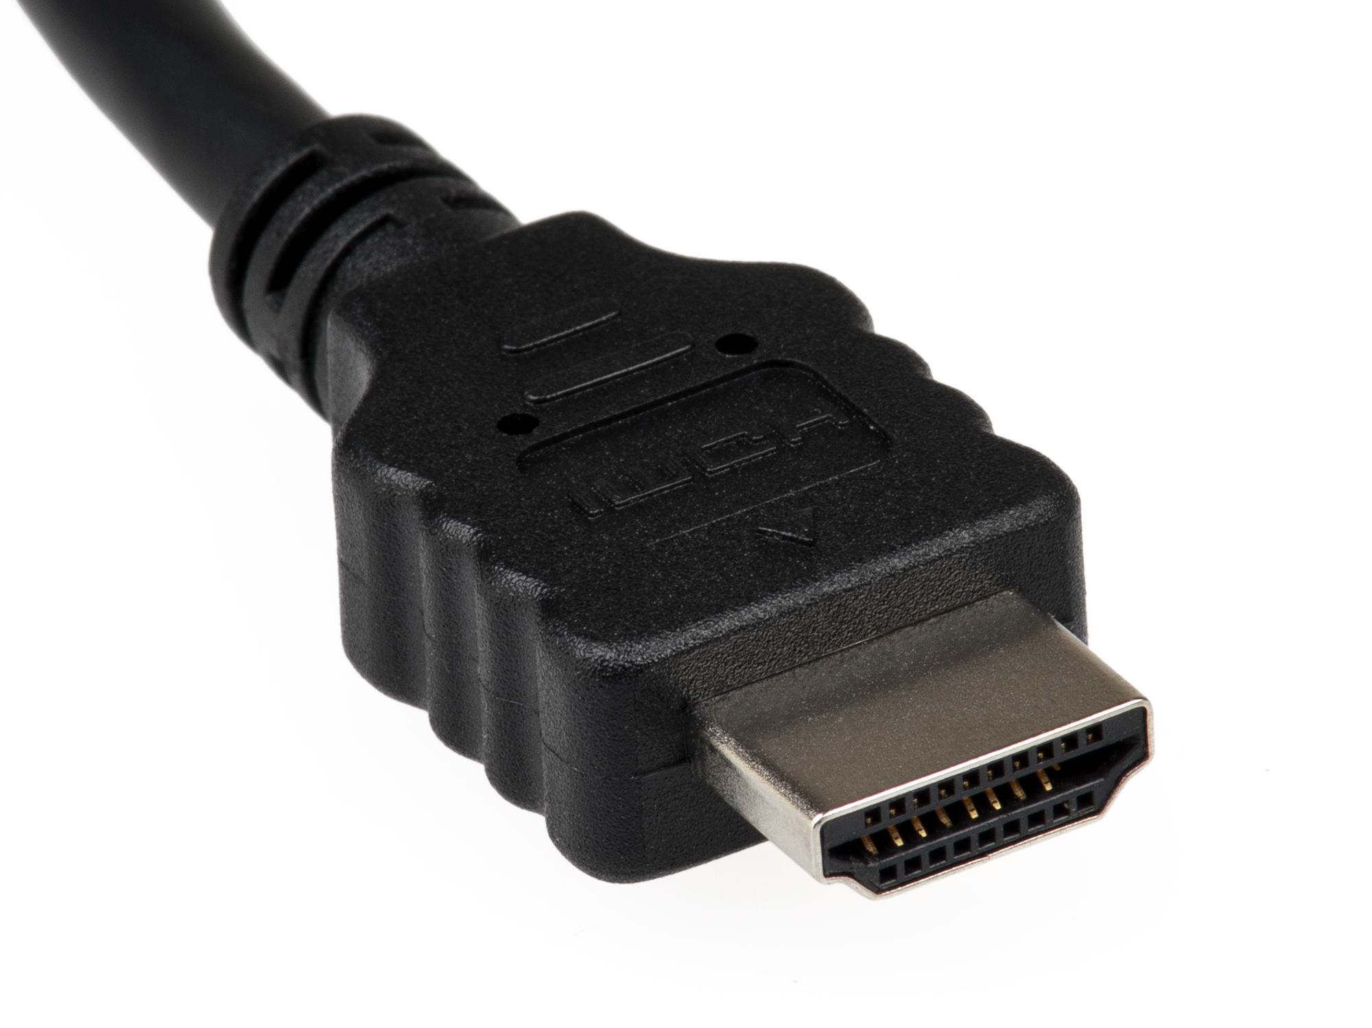
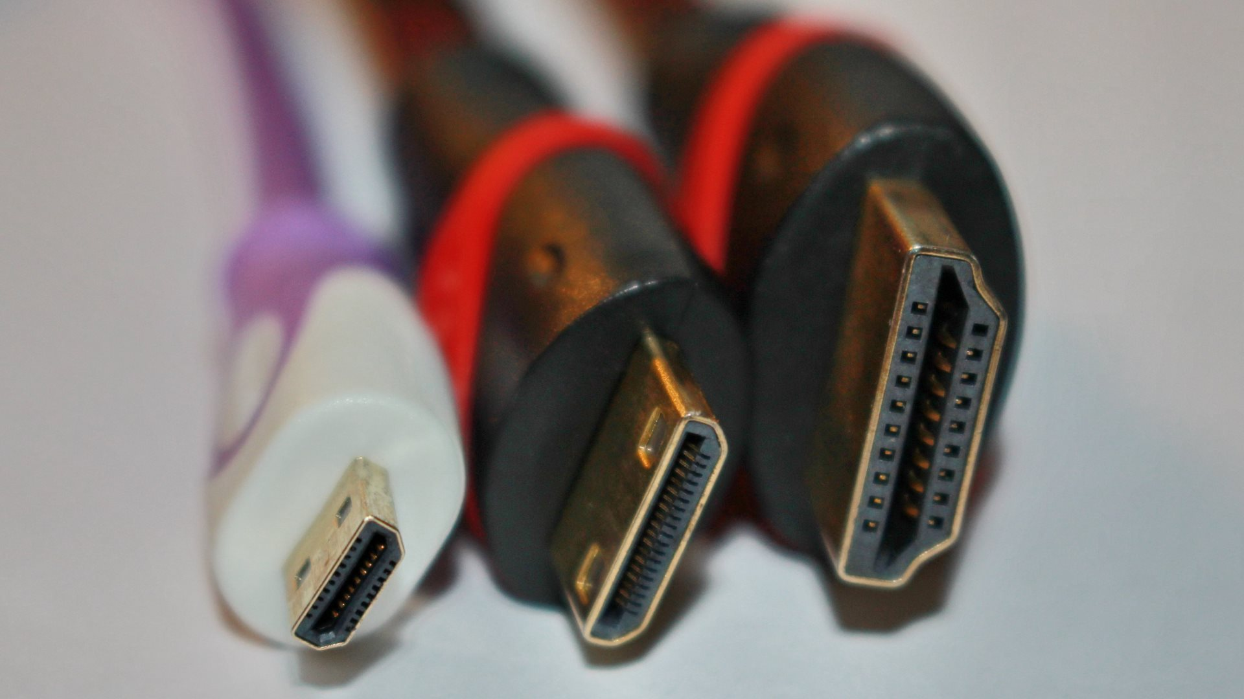
HDMI
High-Definition Multimedia Interface
A video/audio interface for transmitting uncompressed video data, and compressed/uncompressed audio data.
Digital replacement for analog video standards.
Designed: 2002 (7 companies).
HDMI 2.1: 48Gbps.
Newer version: 3D, Ethernet data connection, Consumer Electronics Control (CEC) extensions.

Slide 69
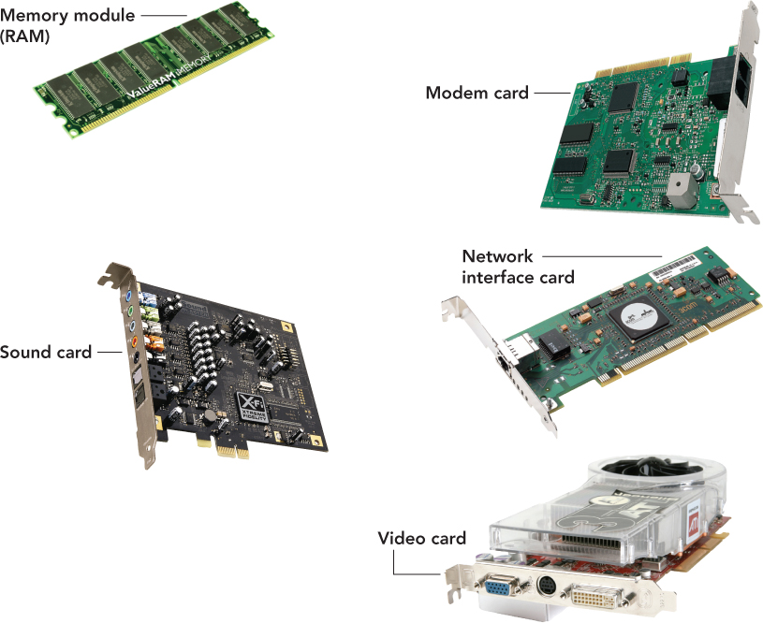
Additional connectors
Telephone
Network
PC card slot
PC card
ExpressCard
Sound card
Game card
TV/sound capture board

Slide 70
What’s on the Outside of the Box?
Legacy technology
Older technology that is being phased out
Examples:
Serial ports
Parallel ports
PS/2 ports
SCSI (small computer system interface) ports

Slide 71
Other Architechtures

Slide 72
Other Architectures
Technologies to increase throughput:
Pipelining: Overlap steps of the machine cycle
Parallel Processing: Use multiple processors simultaneously
SISD: No parallel processing
MIMD: Different programs, different data
SIMD: Same program, different data

Slide 73
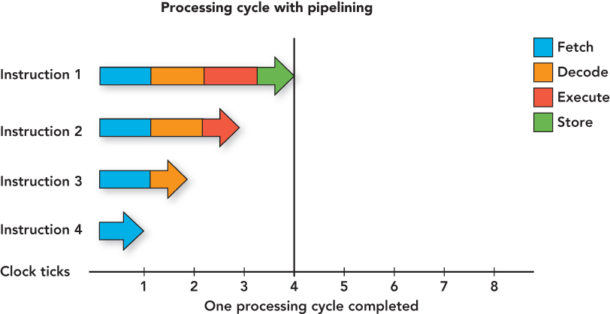
Pipelining

Slide 74
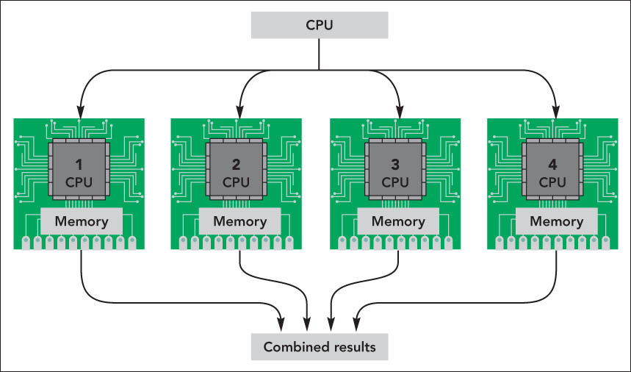
Parallel processing
Method where more than one processor performs at the same time—faster processing

